Slide 1
What is JavaScript ?!!!

Slide 2
JavaScript is a scripting language that enables you to create dynamically updating content, control multimedia, animate images, and pretty much everything else. (Okay, not everything, but it is amazing what you can achieve with a few lines of JavaScript code.)
Too hard to grab…..huh?!
Let’s take some help from an example.

Slide 3

HTML CODE SNIPPET
STYLING OUR PARAGRAPH
p {
font-family: 'helvetica neue’;
letter-spacing: 1px;
text-transform: uppercase;
text-align: center;
border: 2px solid rgba(0,0,200,0.6);
background: rgba(0,0,200,0.3);
color: rgba(0,0,200,0.6);
box-shadow: 1px 1px 2px rgba(0,0,200,0.4);
border-radius: 10px;
padding: 3px 10px;
display: inline-block;
cursor: pointer; }
<p>Player 1: Chris</p>

Slide 4
Bringing things into action…..
const para = document.querySelector('p');
para.addEventListener('click', updateName);
function updateName() {
let name = prompt('Enter a new name');
para.textContent = 'Player 1: ' + name; }

Slide 5
VARIABLES AND DATA-TYPES
Variables are containers that you can store values in. You start by declaring a variable with the var keyword, followed by the name by which you want to call it with.
var myVariable;
You can declare the variable as well as initialize it with some value in the same line
var myVariable = 'Bob';
After giving a variable a value, you can later choose to change it:
var myVariable = 'Bob';
myVariable = 'Steve';

Slide 6
Variable | Explanation | Example
String | A sequence of text known as a string. To signify that the value is a string, you must enclose it in quote marks. | var myVariable = 'Bob';
Number | A number. Numbers don't have quotes around them. | var myVariable = 10;
Boolean | A True/False value. The words true and false are special keywords in JS, and don't need quotes. | var myVariable = true;
Array | A structure that allows you to store multiple values in one single reference. | var myVariable = [1,'Bob','Steve',10]; Refer to each member of the array like this: myVariable[0], myVariable[1], etc.
Object | Basically, anything. Everything in JavaScript is an object, and can be stored in a variable. Keep this in mind as you learn. | var myVariable = document.querySelector('h1'); All of the above examples too.
DATA-TYPES

Slide 7
Arithmetic Operators:
They as their name suggests are, responsible for the arithmetic operations onto numbers or strings.
Operator | Description
+ | Addition
- | Subtraction
* | Multiplication
** | Exponentiation
/ | Division
% | Modulus (Division Remainder)
++ | Increment
-- | Decrement
OPERATORS

Slide 8
Assignment Operators:
They assign values to the JS variables and also have the capability to perform arithmetic operations on the variables.
Operator | Example | Same As
= | x = y | x = y
+= | x += y | x = x + y
-= | x -= y | x = x - y
*= | x *= y | x = x * y
/= | x /= y | x = x / y
%= | x %= y | x = x % y
OPERATORS

Slide 9
String Operators
var txt1 = ”ACM"; var txt2 = ”BVP"; var txt3 = txt1 + " " + txt2;
The ‘+’ operator concatenates the two strings txt1 and txt2, and the output would be as follows:
OPERATORS
ACM BVP
Adding two numbers, will return the sum, but adding a number and a string will return a string.
var x = 5 + 5; var y = "5" + 5; var z = "Hello" + 5;
10 55 Hello5

Slide 10
CONDITIONALS
if (condition)
{ code to run if condition is true }
else
{ run some other code instead }
If….else
Here we've got:
The keyword if followed by some parentheses.
A condition to test, placed inside the parentheses (typically "is this value bigger than this other value", or "does this value exist"). This condition will make use of the comparison operators we discussed in the last module and will return true or false.
A set of curly braces, inside which we have some code — this can be any code we like, and will only be run if the condition returns true.
The keyword else.
Another set of curly braces, inside which we have some more code — this can be any code we like, and will only be run if the condition is not true.

Slide 11
CONDITIONALS
It is perfectly OK to put one if...else statement inside another one to nest them. For example,
if (choice === 'sunny')
{
if (temperature < 86)
{ para.textContent = 'It is ' + temperature + ' degrees outside — nice and sunny. Let\'s go out to the beach, or the park, and get an ice cream.'; }
else if (temperature >= 86)
{ para.textContent = 'It is ' + temperature + ' degrees outside — REALLY HOT! If you want to go outside, make sure to put some suncream on.'; }
}

Slide 12
CONDITIONALS
SWITCH STATEMENTS:
if...else statements do the job of enabling conditional code well, but they are not without their downsides. They are mainly good for cases where you've got a couple of choices, and each one requires a reasonable amount of code to be run, and/or the conditions are complex. For cases where you just want to set a variable to a certain choice of value or print out a particular statement depending on a condition, the syntax can be a bit cumbersome, especially if you've got a large number of choices.
Switch statements are your friend here — they take a single expression/value as an input, and then look through a number of choices until they find one that matches that value, executing the corresponding code that goes along with it. Here's some more pseudocode, to give you an idea:
switch (expression)
{
case choice1: run this code break;
case choice2: run this code instead break;
// include as many cases as you like
default: actually, just run this code
}

Slide 13
CONDITIONALS
Ternary operator:
There is one final bit of syntax we want to introduce you to before we get you to play with some examples. The ternary or conditional operator is a small bit of syntax that tests a condition and returns one value/expression if it is true, and another if it is false — this can be useful in some situations, and can take up a lot less code than an if...else block if you simply have two choices that are chosen between via a true/false condition. The pseudocode looks like this:
( condition ) ? run this code : run this code instead

Slide 14
LOOPS AND ITERATION
For Statement
A for loop repeats until a specified condition evaluates to false.
for ([initialExpression]; [condition]; [incrementExpression]) statement
2. Do…while Statement
The do...while statement repeats until a specified condition evaluates to false. A do...while statement looks as follows:
do
statement
while (condition);
3. While statement
A while statement executes its statements as long as a specified condition evaluates to true. A while statement looks as follows:
while (condition)
statement

Slide 15
ARRAYS
Arrays are generally described as "list-like objects"; they are basically single objects that contain multiple values stored in a list. Array objects can be stored in variables and dealt with in much the same way as any other type of value, the difference being that we can access each value inside the list individually, and do super useful and efficient things with the list, like loop through it and do the same thing to every value.
Creating Arrays
Arrays are constructed of square brackets, which contain a list of items separated by commas.
Let's say we wanted to store a shopping list in an array — we'd do something like the following.
In this case, each item in the array is a string, but bear in mind that you can store any item in an array — string, number, object, another variable, even another array. You can also mix and match item types.
var shopping = [ ‘chips’, ‘popcorn’, ‘cookies’, ‘oats’ ];
var random = [ ‘tree’, 795, [0,1,2] ];

Slide 16
ARRAYS
2. Accessing and Modifying array elements
Enter the following into your console:
You can also modify an item in an array by simply giving a single array item a new value.
3. Finding length
shopping[0]; // returns chips
shopping[0] = ‘nachos’;
shopping;
// returns [‘nachos’, ‘popcorn’, ‘cookies’, ‘oats’ ]
shopping.length;
//Output is 4

Slide 17
FUNCTIONS
Defining functions
A function definition consists of the function keyword, followed by:
The name of the function.
A list of parameters to the function, enclosed in parentheses and separated by commas.
The JavaScript statements that define the function, enclosed in curly brackets, { }.
2. Calling functions
Defining a function does not execute it. Defining the function simply names the function and specifies what to do when the function is called. Calling the function actually performs the specified actions with the indicated parameters.
Function multiply(x, y)
{
return x * y;
};
Multiply(5,6);
//Output would be 30

Slide 18
FUNCTIONS
3. Function Scope
Variables defined inside a function cannot be accessed from anywhere outside the function, because the variable is defined only in the scope of the function. However, a function can access all variables and functions defined inside the scope in which it is defined. In other words, a function defined in the global scope can access all variables defined in the global scope. A function defined inside another function can also access all variables defined in its parent function and any other variable to which the parent function has access.

Slide 19
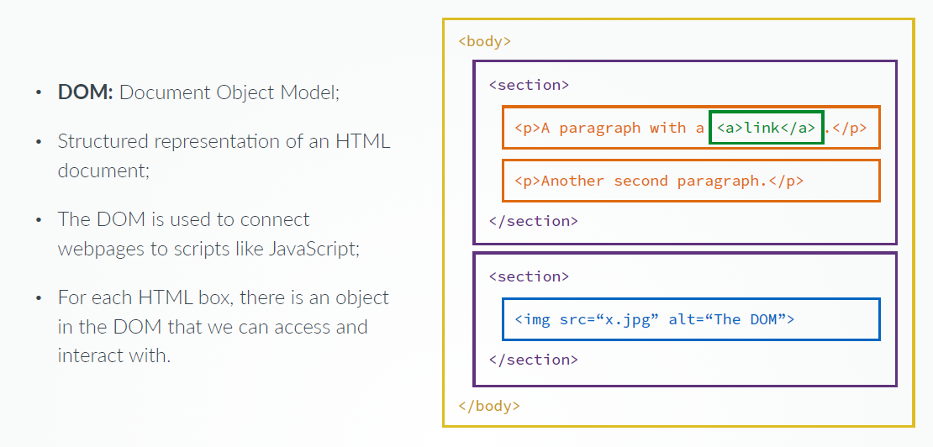
THE DOCUMENT OBJECT MODEL

Slide 20
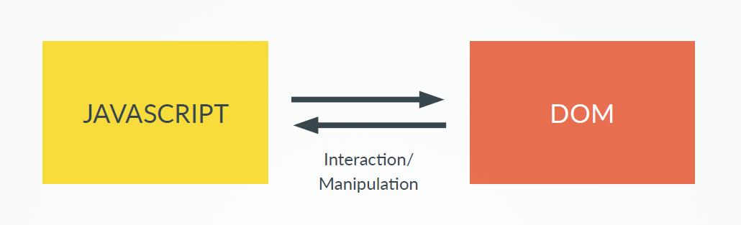
DOM MANIPULATION

Slide 21
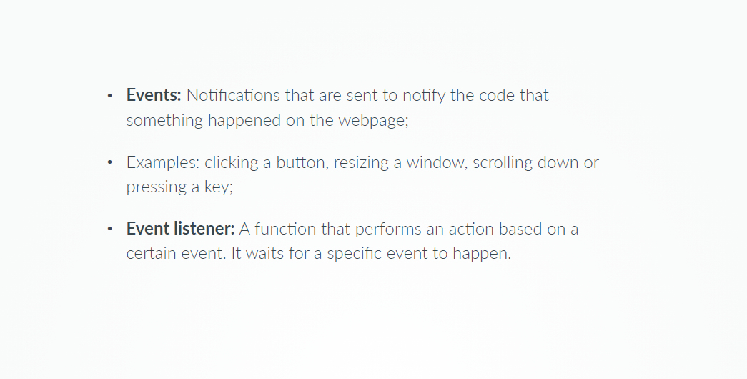
EVENTS

Slide 22
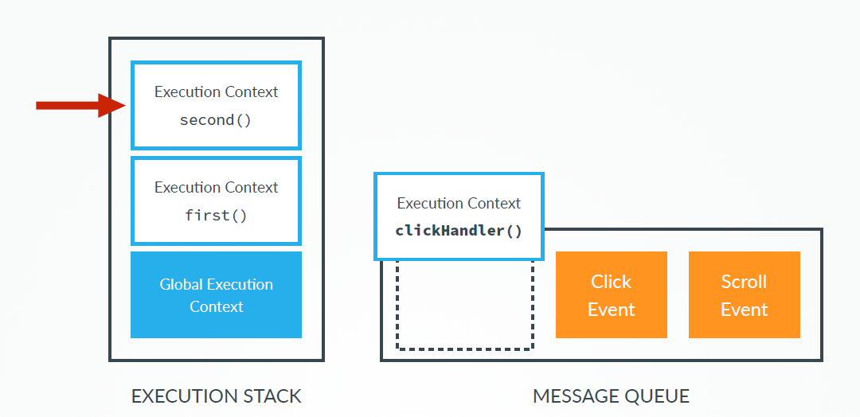
EVENTS AND THEIR PROCESSING

Slide 23
SEE YOU NEXT TIME
☺

